Slide 1

PlatinPie
GIT Training – Round 3
Exercise 04 – Setting Diff- & Merge-Tools
Notes:
1

Slide 2
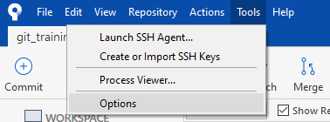
Setting Diff- & Merge-Tools
Under Tools Select Options
Notes:
2

Slide 3
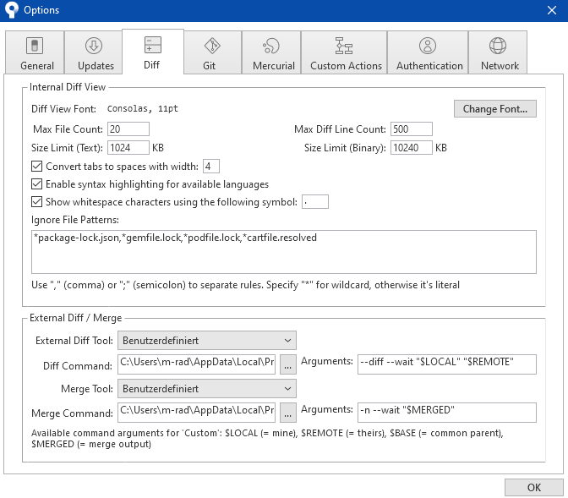
Setting Diff- & Merge-Tools
Select the tab „Diff“
Select your favourite Diff- and Merge-Tool (we have selected VS-Code, but you can use VS or Kdiff or similar!)
You will need to set the Arguments correctly
Notes:
3

Slide 4
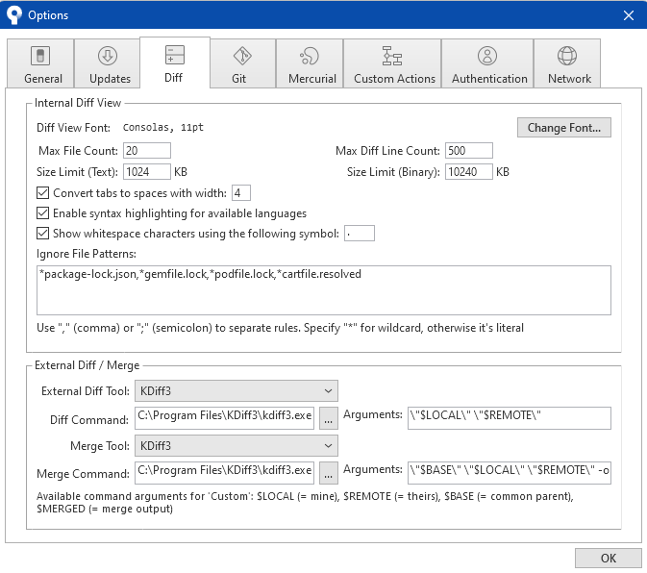
Setting Diff- & Merge-Tools
You can also set Kdiff3 as your Diff- & Merge-Tool (You can download and install it from here: https://sourceforge.net/projects/kdiff3/files/ )
Select KDiff3 (if installed!)
Arguments will be set automatically
Notes:
4

